Slide 1
List Comprehension

Slide 2
1. Operating on Lists

Slide 3
1. If we want to update an entire list
# Use of for loop
for x in l:
x = f(x)

Slide 4
1. If we want to update an entire list
#Define a function
def applylist(f, l):
for x in l:
x = f(x)

Slide 5
Built in function map()

Slide 6
Built in function map()
map(f, l) - applies function - f to each element of l
Ex: map(int, input().split())
In Python 3, output of map(f, l) is not a list
Use list(map(f, l)) to get a list

Slide 7
2. Selecting a sublist
Extract list of primes from list numlist
primelist= [ ]
for i in numlist:
if isprime(i):
primelist.append(i)
return primelist

Slide 8
Built in function filter()
filter(property,list) -
Checks property for each element of list
Output is sublist of values that satisfy the property

Slide 9
Combining map() and filter()
Sum of squares of even numbers from 0 to 99
def square(x):
return (x*x)
def iseven(x):
return(x % 2 == 0)
sum=0
for i in map(square, filter(iseven, range(100))):
sum += i
print (sum)

Slide 10
List Comprehension
Combining map() and filter() without using them
List Comprehension is building a new list from an existing list.
Ex: Squares of even numbers below 100 without using map() and filter()
[square(x) for i in range(100) if iseven(x)]
map generator filter

Slide 11
Multiple Generators
Pythagorean triples with x, y, z below 100
[(x, y, z) for x in range(1, 100)
for y in range (x, 100)
for z in range (y, 100)
if x*x + y*y == z*z]

Slide 12
List Comprehension is useful for initializing lists
Initialize a 4 x 3 matrix
l = [ [ 0 for i in range(3) ]
for j in range (4)] # j - row, i - column

Slide 13
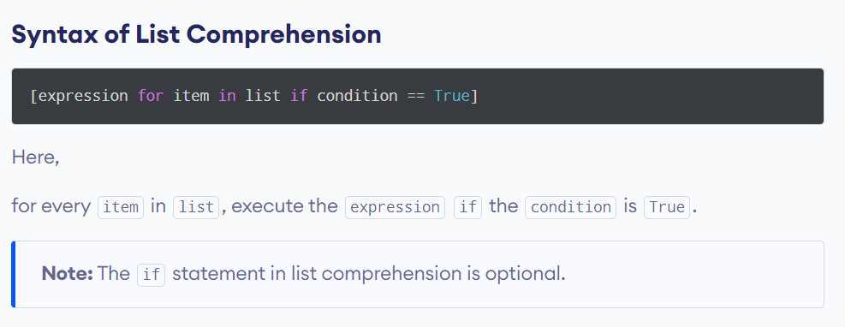
Syntax of list comprehension

Slide 14
Examples of list comprehension
# filtering even numbers from a list
even_numbers = [num for num in range(1, 10) if num % 2 == 0 ]
print(even_numbers)

Slide 15
Examples of list comprehension
# find vowel in the string "Python"
word = "Python"
vowels = "aeiou"
result = [char for char in word if char in vowels]
print(result)

Slide 16

Nested List Comprehension
# Compute Multiplication Table
multiplication = [[i * j for j in range(1, 6)] for i in range(2, 5)]
print(multiplication)
Output:
[[2, 4, 6, 8, 10], [3, 6, 9, 12, 15], [4, 8, 12, 16, 20]]

Slide 17
4. How to Input Multiple Strings Separated by Space
For Ex. : Rohit Rahul Virat Hardik
str1=input() #As of now, str1 is a single string, NOT a list

Slide 18
4. How to Input Multiple Strings Separated by Space
For Ex. : Rohit Rahul Virat Hardik
str1=input() #As of now, str1 is a single string, NOT a list
list1=str1.split() #After split(), we always get a list

Slide 19
4. How to Input Multiple Strings Separated by Space
For Ex. : Rohit Rahul Virat Hardik
str1=input() #As of now, str1 is a single string, NOT a list
list1=str1.split() #After split(), we always get a list
#Now, list1[0]=‘Rohit’

Slide 20
4. How to Input Multiple Strings Separated by Space
For Ex. : Rohit Rahul Virat Hardik
str1=input() #As of now, str1 is a single string, NOT a list
list1=str1.split() #After split(), we always get a list
#Now, list1[0]=‘Rohit’
#list1[1]=‘Rahul’ and so on.

Slide 21
5. How to Input Multiple Strings Separated by Comma

Slide 22
5. How to Input Multiple Strings Separated by Comma
For Ex. : Rohit,Rahul,Virat,Hardik

Slide 23
5. How to Input Multiple Strings Separated by Comma
For Ex. : Rohit,Rahul,Virat,Hardik
str1=input() #As of now, str1 is a single string, NOT a list

Slide 24
5. How to Input Multiple Strings Separated by Comma
For Ex. : Rohit,Rahul,Virat,Hardik
str1=input() #As of now, str1 is a single string, NOT a list
list1=str1.split(‘,’) #After split(), we always get a list

Slide 25
5. How to Input Multiple Strings Separated by Comma
For Ex. : Rohit,Rahul,Virat,Hardik
str1=input() #As of now, str1 is a single string, NOT a list
list1=str1.split(‘,’) #After split(), we always get a list
#Now, list1[0]=‘Rohit’

Slide 26
5. How to Input Multiple Strings Separated by Comma
For Ex. : Rohit,Rahul,Virat,Hardik
str1=input() #As of now, str1 is a single string, NOT a list
list1=str1.split(‘,’) #After split(), we always get a list
#Now, list1[0]=‘Rohit’
#list1[1]=‘Rahul’ and so on.

Slide 27
6. How to Input Multiple Strings One Below the Other

Slide 28
6. How to Input Multiple Strings One Below the Other
For Ex. :
Rohit
Rahul
Virat
Hardik

Slide 29
n=int(input()) #This is the number of elements

Slide 30
n=int(input()) #This is the number of elements
list1=[] #Start with an empty list

Slide 31
n=int(input()) #This is the number of elements
list1=[] #Start with an empty list
for i in range(n):
list1.append(input())

Slide 32
7. How to Input Multiple Strings Within Square Brackets Separated by Comma
For Ex. : [‘Rohit’,‘Rahul’,‘Virat’,‘Hardik’]

Slide 33
str=input()
string_list = str.strip("[]").split(',')
string_list = [s.strip() for s in string_list]
print(string_list)

Slide 34
8. How to Input Multiple Integers Separated by Space

Slide 35
8. How to Input Multiple Integers Separated by Space
For Ex. : 2 4 6 8

Slide 36
8. How to Input Multiple Integers Separated by Space
For Ex. : 2 4 6 8
str1=input() #As of now, str1 is a single string, NOT a list

Slide 37
8. How to Input Multiple Integers Separated by Space
For Ex. : 2 4 6 8
str1=input() #As of now, str1 is a single string, NOT a list
list1=str1.split() #After split(), we always get a list

Slide 38
8. How to Input Multiple Integers Separated by Space
For Ex. : 2 4 6 8
str1=input() #As of now, str1 is a single string, NOT a list
list1=str1.split() #After split(), we always get a list
#But, as of now, list1 is a list of strings, but NOT integers

Slide 39
8. How to Input Multiple Integers Separated by Space
For Ex. : 2 4 6 8
str1=input() #As of now, str1 is a single string, NOT a list
list1=str1.split() #After split(), we always get a list
#But, as of now, list1 is a list of strings, but NOT integers
list1=[int(i) for i in list1] #Now we get a list of integers

Slide 40
9. How to Input Multiple Integers Separated by Comma

Slide 41
9. How to Input Multiple Integers Separated by Comma
For Ex. : 2,4,6,8

Slide 42
9. How to Input Multiple Integers Separated by Comma
For Ex. : 2,4,6,8
str1=input() #As of now, str1 is a single string, NOT a list

Slide 43
9. How to Input Multiple Integers Separated by Comma
For Ex. : 2,4,6,8
str1=input() #As of now, str1 is a single string, NOT a list
list1=str1.split(‘,’) #After split(), we always get a list
#But, as of now, list1 is a list of strings, but NOT integers

Slide 44
9. How to Input Multiple Integers Separated by Comma
For Ex. : 2,4,6,8
str1=input() #As of now, str1 is a single string, NOT a list
list1=str1.split(‘,’) #After split(), we always get a list
#But, as of now, list1 is a list of strings,but NOT integers
list1=[int(i) for i in list1] #Now we get a list of integers

Slide 45
10. How to Input Multiple Integers One Below the Other

Slide 46
10. How to Input Multiple Integers One Below the Other
For Ex. :
2
4
6
8

Slide 47
n=int(input()) #This is the number of elements

Slide 48
n=int(input()) #This is the number of elements
list1=[] #Start with an empty list

Slide 49
n=int(input()) #This is the number of elements
list1=[] #Start with an empty list
for i in range(n):
list1.append(int(input()))

Slide 50
11. How to Input Multiple Integers Within Square Brackets Separated by Comma

Slide 51
11. How to Input Multiple Integers Within Square Brackets Separated by Comma
For Ex. : [2,4,6,8]

Slide 52
s=input()
s=s.strip("[]")
l=list(map(int,s.split(',')))

Slide 53
12. How to Print Elements of a List in a Single Line Separated by Space
For Ex. : 2 4 6 8

Slide 54
12. How to Print Elements of a List in a Single Line Separated by Space
For Ex. : 2 4 6 8
list1=[2,4,6,8]

Slide 55
12. How to Print Elements of a List in a Single Line Separated by Space
For Ex. : 2 4 6 8
list1=[2,4,6,8]
print(*list1) #This will print elements of list1 in a single line separated by space

Slide 56
13. How to Print Elements of a List in a Single Line Separated by Comma

Slide 57
13. How to Print Elements of a List in a Single Line Separated by Comma
For Ex. : 2,4,6,8

Slide 58
13. How to Print Elements of a List in a Single Line Separated by Comma
For Ex. : 2,4,6,8
list1=[2,4,6,8]

Slide 59
13. How to Print Elements of a List in a Single Line Separated by Comma
For Ex. : 2,4,6,8
list1=[2,4,6,8]
print(*list1,sep=‘,’) #This will print elements of list1 in a single line separated by space

Slide 60
14. How to Print Elements of a List One Below the Other

Slide 61
14. How to Print Elements of a List One Below the Other
For Ex. :
2
4
6
8

Slide 62
list1=[2,4,6,8]
print(*list1,sep=‘\n’) #This will print elements of list1 one below the other

Slide 63
15. How to Print Elements of a List Within Square Brackets

Slide 64
15. How to Print Elements of a List Within Square Brackets
For Ex. : [2,4,6,8]

Slide 65
15. How to Print Elements of a List Within Square Brackets
For Ex. : [2,4,6,8]
list1=[2,4,6,8]
print(list1) #This will print elements of list1 within square brackets

